Slide 1
Fully Connected
Neural Network
(FCNN)
Stian Stensli, Trygve Vang, Henrik Kronborg

Slide 2
Topics
Neuron
Perceptron
FCNN
Learning

Slide 3
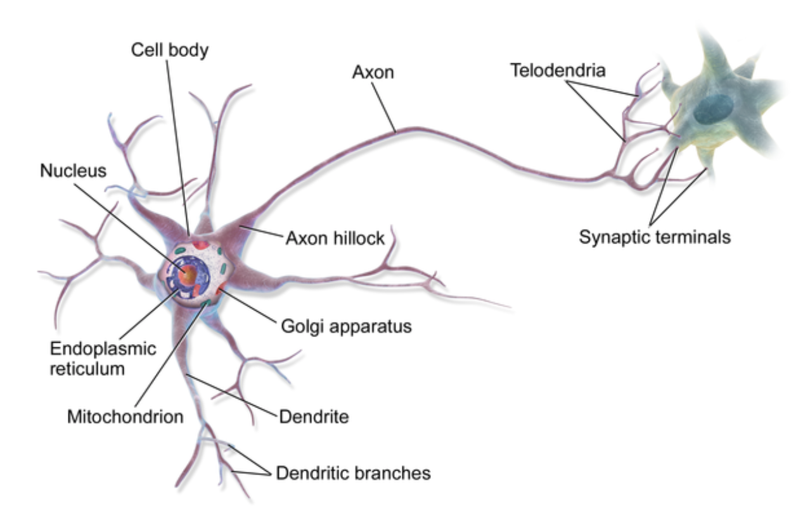
Neurons
The nodes of a neural network
Researched since 1943 - Theory of how the brain might work - Managed to learn simple boolean expressions
Notes:
[S] For å få en god introduksjon til

Slide 4
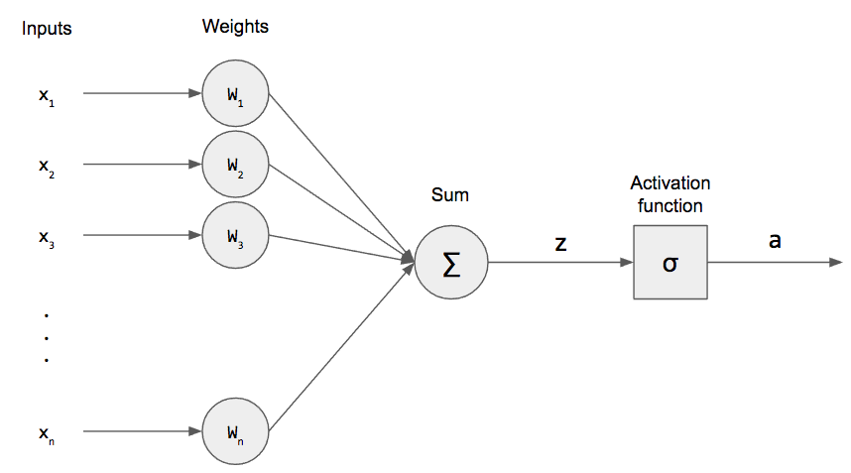
Perceptron
Consists of:
Inputs: x_{n}
Weights: w_{n}
Bias: b
A sum: Z
An activation function: σ
Output: a
Input/output mapping by an activation function
Weights and bias are learnable parameters
Notes:
[S]

Slide 5
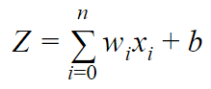
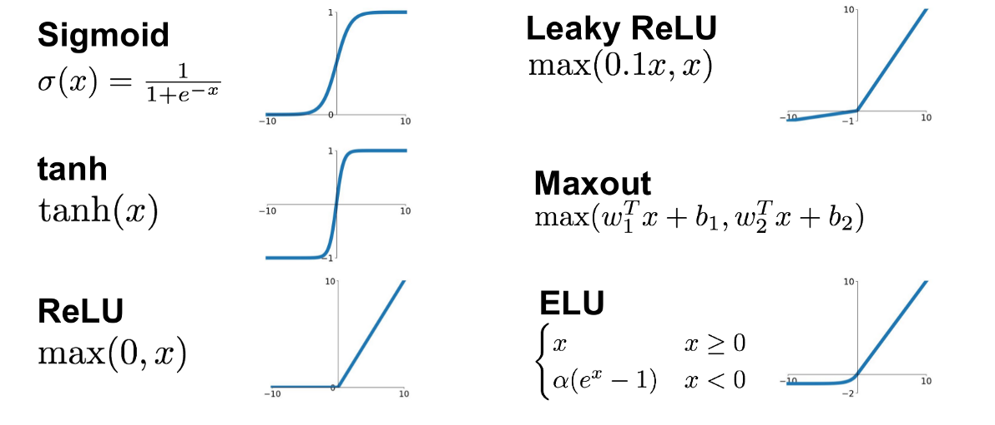
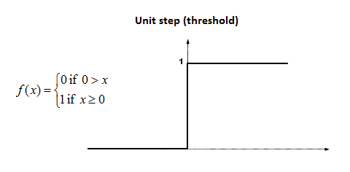
Activation functions
Converts input signals (Z) to an output signal
Xn: Output from node n
Wn: Weight n
Output is fed to the next layer
Notes:
[S] Vanishing gradient problem (tanh, sigmoid) “Simply saying that ReLu could result in Dead Neurons.” “ReLu… limitation is that it should only be used within Hidden layers” “Leaky ReLu eller maxout fikser dead node problemet”

Slide 6

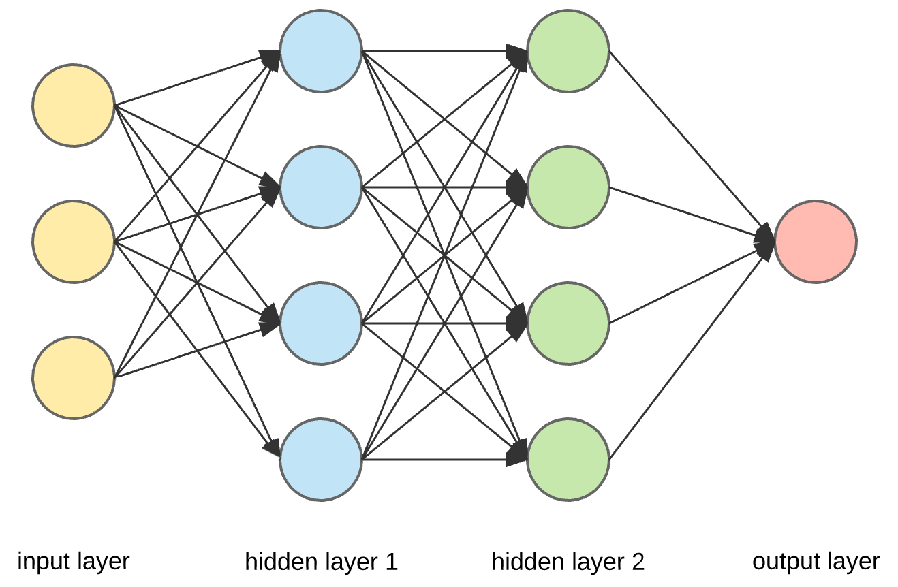
Fully Connected Neural Network
Each perceptron is connected to all perceptrons in the previous and next layer
Very basic network
One or more fully connected layers are often used in neural networks
Notes:
[H]

Slide 7
Learning
Data set is split into training data, test data (and sometimes validation data)
Foreach Epoch
Foreach element in training data
Send element as input to the network
Calculate error with cost function
Propagate error backwards to adjust weights
If use of validation data, calculate accuracy
Calculate accuracy using test data
Notes:
[H]

Slide 8

Feed forward
The output from the previous layer determines the result of the current layer
Notes:
[H]

Slide 9
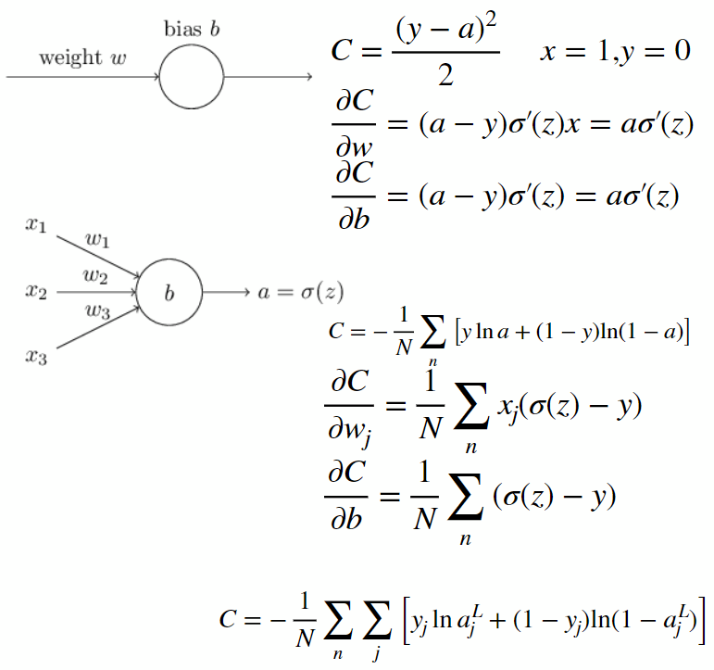
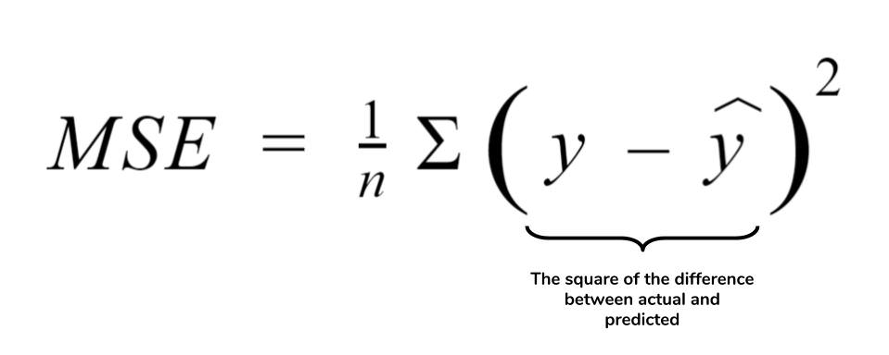
Cost function
Many cost functions
Mean Squared Error (MSE)
Cross Entropy
Calculate error based on expected output
Used to find how much weights should be adjusted
Notes:
[T]

Slide 10
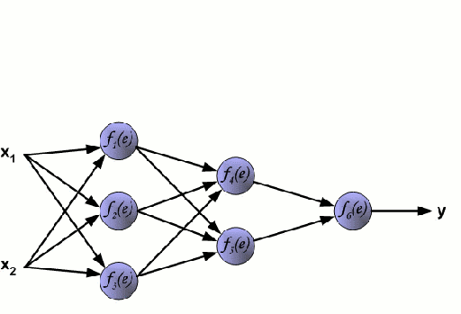
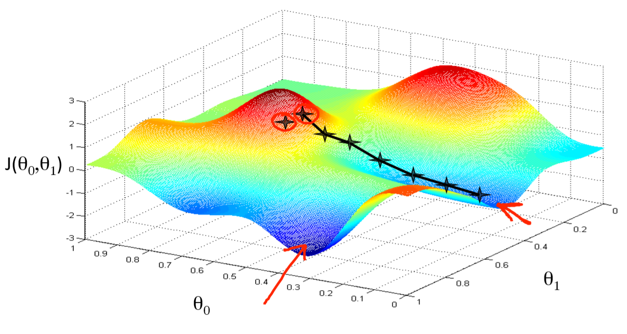
Backpropagation/Gradient descent
Propagate error from cost from output to input
Learning: weight updating
Notes:
[T]
GIF:
Kjører feed forward
Gjør backtracking hvor det beregnes en error gradient for hvert layer
Beregner en vekt korrigering ved å ta learning rate * x (input) * error gradient
Oppdaterer vektene ved å plusse på utregnet korrigering

